Slide 2
Presenter
Richard DeVenezia
Programmer Analyst, Johnson & Johnson
Richard has worked at Johnson & Johnson in the Medical Device Epidemiology group for two years. He has been a SAS programmer and system developer in a wide range of industries and roles since 1990.

Slide 3
ODS EXCEL
Tips and Tricks for PROC TABULATE

Slide 4


ODS Excel
Now in Production SAS9.4M3
Good bye tagsets.ExcelXP
  Good bye custom options() ☹
Hello online documentation
Technical support

Slide 5
Study
Medical Devices Epidemiology group
Protocol document
  Retrospective observational study for xyz…
Details for cohort selection
  ICD-9 Procedures, Age, Elective, etcetera
  Partitions according to treatment / operant classification vars
Details for study variables
  Binary flags – Conditions or event occurrence
  Categorical – Demographic, characteristic, etcetera
  Continuous – $, time, bmi, units

Slide 6
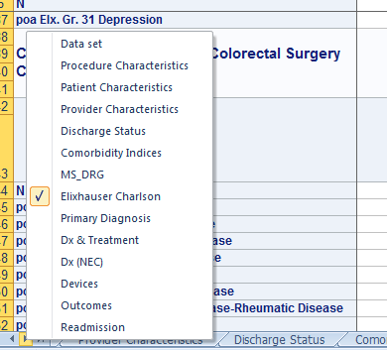
Summary Report in Excel
Counts and Column %s
Tabs for different variable
groups (not by groups)
Each tab
  One or more TABULATES
  Similar look

Slide 7
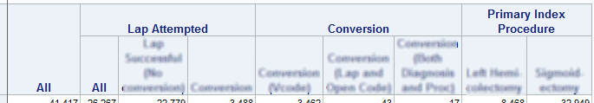
Summary Report in Excel
Counts and Column %s
Columns
Same in each tab
Partition variables

Slide 8
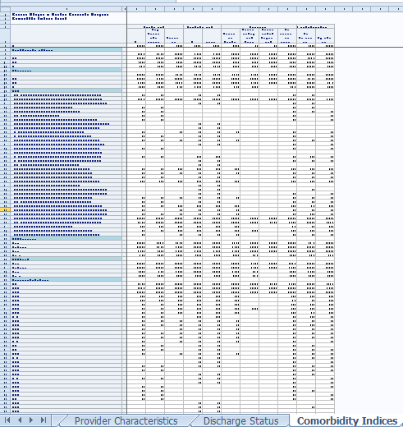
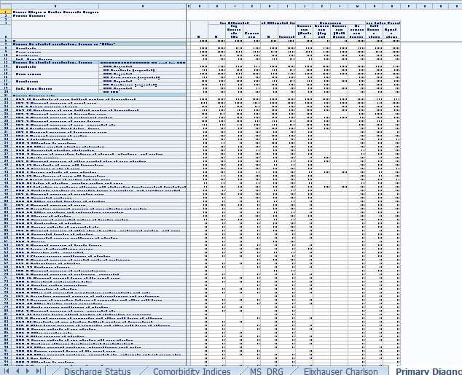
Summary Report in Excel
Can go on and on

Slide 9
Tabs
One macro per tab
Flexible
Consistent and not constraining
  Each macro does some things the same
  Tweaks for special conditions for sets of variables
  Nested row headers

Slide 10
One macro per tab
ods excel ...
%Dataset
%ProcedureCharacteristics
%PatientCharacteristics
%ProviderCharacteristics
%DischargeStatus
%ComorbidityIndices
%ElixhauserCharlson
%PrimaryDiagnosis
%DxTreatment
%NEC
%Devices
%Outcomes
%Readmission
ods excel close;

Slide 11
Guarantee new tab
Prior programs used Tagsets.ExcelXP
New sheet_name always worked
Not so in 9.4M2
Work around used in each macro
%macro new_sheet(name=);
ODS EXCEL OPTIONS(SHEET_INTERVAL="TABLE" SHEET_NAME=&NAME);
ODS SELECT NONE; DATA _NULL_; DCL odsout obj(); RUN;
ODS SELECT ALL;
ODS EXCEL OPTIONS(SHEET_INTERVAL="NONE" SHEET_NAME=&NAME);
ODS SELECT NONE; DATA _NULL_; DCL odsout obj(); RUN;
ODS SELECT ALL;
%mend;

Slide 12
Goal is understood
How to make it happen ?
Macros need to be coded
Iterations
Layout
Updated data
  Variables
  Sub-cohort
Updated classification

Slide 13
TIP
Avoid File is in use
ERROR: File is in use
Avoid two submits going to same file
ODS EXCEL FILE=%NextFilename(StudyDataReview);
…
ODS EXCEL FILE=%NextFilename(StudyDataReview);
%macro NextFilename (basename); %global nextfile;
%let nextfile =
"%sysfunc(pathname(WORK))\&basename (%sysfunc(DATE(),yymmdd10.)) #%sysfunc(monotonic()).xlsx"
;&nextfile
%mend;

Slide 14
TIP
Avoid running whole program
… couple of lines of SAS code …
data _null_;
abort cancel;
run;
… thousands of lines of SAS code …

Slide 15
Proc TABULATE
TABLE statement
From SAS Docs
TABLE <<page-expression,> row-expression,>
column-expression </ table-option(s)>;
TIP:
A variables role is set by listing it in a CLASS or VAR statement
Categorical -> CLASS
Continuous -> VAR
Binary -> VAR

Slide 16
Simple to complex
Iterative process
Hands on learning
  By example
  By variation
proc tabulate data=SGF17;
class type approach;
table n, type*approach;
label type = 'Surgery';
label approach = 'Technique';
run;
 | Surgery
 | Left Hemicolectomy |  | Sigmoidectomy
 | Technique |  | Technique
 | Lap | Open | Lap | Open
N | 3866 | 4602 | 19027 | 13922

Slide 17
Simple to complex
Remove the variable names and have commas for the counts.
 | Surgery
 | Left Hemicolectomy |  | Sigmoidectomy
 | Technique |  | Technique
 | Lap | Open | Lap | Open
N | 3866 | 4602 | 19027 | 13922
proc tabulate data=SGF17; class type approach; table n*f=comma9., type=''*approach=''; run;
 | Left Hemicolectomy |  | Sigmoidectomy
 | Lap | Open | Lap | Open
N | 3,866 | 4,602 | 19,027 | 13,922

Slide 18
Simple to complex
Add total columns for type and approach
class type approach; table n*f=comma9. , (all type='') * (all approach='') ;
 | All |  |  | Left Hemicolectomy |  |  | Sigmoidectomy
 | All | Lap | Open | All | Lap | Open | All | Lap | Open
N | 41,417 | 22,893 | 18,524 | 8,468 | 3,866 | 4,602 | 32,949 | 19,027 | 13,922

Slide 19
Simple to complex
That’s too much ALL. I need only a single ALL column for the N=41,417
Dimensional expressions are powerful constructs
class type approach; table n*f=comma9. , all type='' * approach='';
 | All | Left Hemicolectomy |  | Sigmoidectomy
 |  | Lap | Open | Lap | Open
N | 41,417 | 3,866 | 4,602 | 19,027 | 13,922

Slide 20
Simple to complex
TRICKY
N counts in the column headers.
SUMMARYize column hierarchy levels as types
  () ()*(type) ()*(type)*(approach)
  Merge counts at each level into original data as (n=##,###)
table n*f=comma9. , all level0_count='' * type='' * level1_count='' * approach='';
 | All | (n=41,417)
 |  | Left Hemicolectomy |  | Sigmoidectomy
 |  | (n=8,468) |  | (n=32,949)
 |  | Lap | Open | Lap | Open
N | 41,417 | 3,866 | 4,602 | 19,027 | 13,922

Slide 21
Simple to complex
TIP
Use a macro for column expression
%macro columns_TypeApproach;
all
type = ' ' * approach = ' '
%mend;
%macro columns_TypeApproach_withCounts;
all
level0_count='' * type=''
* level1_count='' * approach=''
%mend;

Slide 22
Simple to complex
TIP
Use a macro for column expression
%macro columns_TypeApproach;
all
type = ' ' * approach = ' '
%mend;
%macro columns_TypeApproach_withCounts;
all
level0_count='' * type=''
* level1_count='' * approach=''
%mend;

Slide 23
Simple to complex
Make SIGMOID and OPEN appear first in the column headers.
Order by format or value
class level0_count level1_count;
class type / descending;
class approach / preloadfmt order=data;
format approach $OpenLap.;
table n*f=comma9.
, %columns_TypeApproach ;
 | All | Sigmoidectomy |  | Left Hemicolectomy
 |  | Open | Lap | Open | Lap
N | 41,417 | 13,922 | 19,027 | 4,602 | 3,866

Slide 24
Boost – Leading spaces
Trick
Value transformation
Or custom format (CLASS / ORDER=FORMATTED)
data letters;
do letter = 'A0'x||'A', 'B', ' C', 'D', 'E', 'F';
output;
end;
run;
proc tabulate data=letters;
class letter;
table n, letter;
run;
 | letter
 | C | B | D | E | F | A
N | 1 | 1 | 1 | 1 | 1 | 1

Slide 25
Rows
Categorical age, gender and payer
 |  | Sigmoidectomy
 |  | Open | Lap
Age |  | 1,486 | 2,862
18-44 | N
45-54 | N | 2,929 | 4,832
55-64 | N | 3,782 | 5,360
65-74 | N | 3,406 | 4,055
75 plus | N | 2,319 | 1,918
Gender |  | 7,539 | 9,863
Female | N
Male | N | 6,383 | 9,164
Payer |  | 5,798 | 5,986
Medicare | N
Medicaid | N | 792 | 736
Commercial | N | 6,347 | 11,253
Other | N | 985 | 1,052
proc tabulate data=SGF17_v2;
%colvars_TypeApproach_slim;
class age gender std_payor;
table
(age gender std_payor) * n*f=comma9.
, %columns_TypeApproach_slim
;
run;

Slide 26
Simple to complex
Reduce the font, show COLPCTN, no stat label
 |  | Sigmoidectomy
 |  | Open | Lap
Age |  | 10.67 | 15.04
18-44
45-54 |  | 21.04 | 25.40
55-64 |  | 27.17 | 28.17
65-74 |  | 24.46 | 21.31
75 plus |  | 16.66 | 10.08
Gender |  | 54.15 | 51.84 | Can you fix these combined cells?
Female
Male |  | 45.85 | 48.16
Payer |  | 41.65 | 31.46
Medicare
Medicaid |  | 5.69 | 3.87
Commercial |  | 45.59 | 59.14
Other |  | 7.08 | 5.53
proc template;
define style sdf17_sample;
style Header from _self_ / fontsize=8pt;
table
(age gender std_payor) * colpctn=' '*f=6.2
, %columns_TypeApproach_slim
;

Slide 27
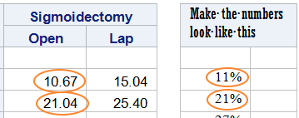
Simple to complex
No merged cells, distinguish the names from values
 |  | Sigmoidectomy |  |  | Make the numbers look like this
 |  | Open | Lap
Age
18-44 |  | 10.67 | 15.04 |  | 11%
45-54 |  | 21.04 | 25.40 |  | 21%
55-64 |  | 27.17 | 28.17 |  | 27%
65-74 |  | 24.46 | 21.31 |  | 24%
75 plus |  | 16.66 | 10.08 |  | Etc…
Gender
Female |  | 54.15 | 51.84
Male |  | 45.85 | 48.16
class age gender std_payor
/ style=[background=lightblue];
classlev age gender
/ style=
[background=white pretext='a0a0'x];
table
(age gender) * colpctn=''*f=6.2
, %columns_TypeApproach_slim
/ nocellmerge

Slide 28
Simple to complex
Values as numbers with % after them
table
(age gender)
* colpctn=''*f=9.2
* [s=[tagattr='format:0\%;;-_)']]
, %columns_TypeApproach_slim
/ nocellmerge
;
 |  | Sigmoidectomy
 |  | Open | Lap
Age
18-44 |  | 11% | 15%
45-54 |  | 21% | 25%
55-64 |  | 27% | 28%
65-74 |  | 24% | 21%
75 plus |  | 17% | 10%
Gender
Female |  | 54% | 52%
Male |  | 46% | 48%

Slide 29
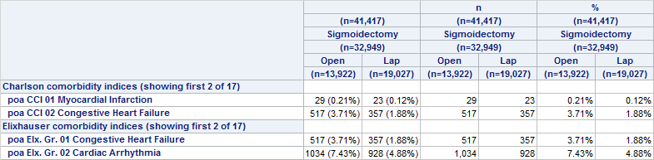
Most complex
Cause Excel formula via tagattr
…
*[s=[tagattr='formula:RC[2]&amp;char(32)&amp;"("&amp;TEXT(RC[4],"0.00%")&amp;")"']]
sum='n'*f=comma9.
mean='%'*f=9.4*[s=[tagattr='format:0.00%;;-_)']]
)
…

Slide 30
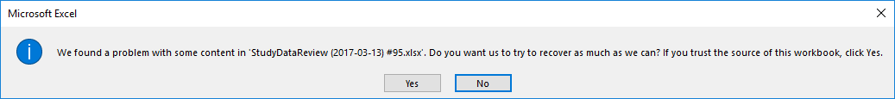
Debugging
Incorrect TAGATTR can make problems
Rename .xlsx as .zip, review .xml
Here is a sample of the destination xml when the formula was not quite right
<row r="8" ht="12" customHeight="1">
<c r="A8" s="7" t="s"><v>12</v></c>
<c r="B8" s="8"><f>D8&</f></c>
<c r="C8" s="8"><f>E8&</f></c>

Slide 31
ODS EXCEL
OPTIONS(option-name="option-value")
ABSOLUTE_COLUMN_WIDTH
ABSOLUTE_ROW_HEIGHT
AUTOFILTER
BLACKANDWHITE
BLANK_SHEET
CENTER_HORIZONTAL
CENTER_VERTICAL
COLUMN_REPEAT
CONTENTS
DPI
DRAFTQUALITY
EMBEDDED_FOOTNOTES
EMBED_FOOTNOTE_ONCE
EMBEDDED_TITLES
EMBED_TITLES_ONCE
FITTOPAGE
FORMULAS
FROZEN_HEADERS
FROZEN_ROWHEADERS
GRIDLINES
HIDDEN_COLUMNS
HIDDEN_ROWS
INDEX
MSG_LEVEL

Slide 32
ODS EXCEL
OPTIONS(option-name="option-value")
ORIENTATION
PAGE_ORDER
PAGES_FITHEIGHT
PRINT_AREA
PRINT_FOOTER
PRINT_FOOTER_MARGIN
PRINT_HEADER
PRINT_HEADER_MARGIN
ROWBREAKS_COUNT
ROWWBREAKS_INTERVAL
ROWCOLHEADINGS
ROW_HEIGHTS
ROW_REPEAT
SCALE
SHEET_INTERVAL
SHEET_LABEL
SHEET_NAME
START_AT
SUPPRESS_BY_LINES
TAB_COLOR
TITLE_FOOTNOTE_BREAK
TITLE_FOOTENOTE_WIDTH
ZOOM

Slide 33
Thanks !

Slide 34
Don't Forget to Provide Feedback!
Go to the Agenda icon in the conference app.
Find this session title and select it.
On the sessions page, scroll down to Surveys and select the name of the survey.
Complete the survey and click Finish.

