Slide 2
Richard A. DeVenezia
Long time user and advocate for using SAS solutions

Slide 3
Exclusive Data Set Access in a Stored Process Web Application:
Macros for mutexes in Windows®
Richard A. DeVenezia, Independent Consultant

Slide 4
Unpacking the title
Exclusive
Stored Process Web Application
Macros
Mutexes
Windows

Slide 5
Exclusivity
Probability
  Two events cannot occur at the same time
Physics
  Pauli’s exclusion principle
Programming
  Concurrency control property
  Only one thread at a time in critical sections

Slide 6
Exclusivity
Mutex
  Synchronization object
  State signaled when available
  Windows system object
Accessible via MODULEN
  SASCBTBL

Slide 7
Synchronization Object - CreateMutex
HANDLE CreateMutexW(
LPSECURITY_ATTRIBUTES lpMutexAttributes,
BOOL bInitialOwner,
LPCWSTR lpName );
Creates or opens existing
True, thread owned
Global\\STPAPP.<data set name>

Slide 8
State Signaled - WaitForSingleObject
DWORD WaitForSingleObject(
HANDLE hHandle,
DWORD dwMilliseconds );
Waits until the specified object is in the signaled state or the time-out interval elapses.

Slide 9
State Unsignaled - ReleaseMutex
BOOL ReleaseMutex (
HANDLE hHandle );
Releases ownership
OS chooses an awaiting

Slide 10
STP anticipated scenario
Thread A creates XYZ
A awaits XYZ
A signaled XYZ, locks for critical
B awaits on XYZ
A releases XYZ
B signaled XYZ, locks for critical
B releases XYZ
Everybody happy?

Slide 11
Scenario problem
Stored Process Server
Multi-bridge connections
  Concurrent STP execution
  A, B, C, D, …
  Default 3
Connection (thread) quiesces
  OS closes mutexes
  Others error or timeout

Slide 12
Service program
Run outside STP Server
  Startup program
  Service
CreateMutex
  One per data set used
  OS reference count #1
STPs will OpenMutex
  #2,…

Slide 13
STP threads - OpenMutex
HANDLE OpenMutexW(
DWORD dwDesiredAccess,
BOOL bInheritHandle,
LPCWSTR lpName );
SYNCHRONIZE
Name must exist

Slide 14
Recap
CreateMutex, OpenMutex, ReleaseMutex, WaitForSingleObject
%syscall MODULE Routine
Abandoned resources
Extra-server needed

Slide 15
STP_MUTEXES.c
Service Program
Read file of names
CreateMutex
  Global\\STPAPP.MutexName
Sleep (INFINITE)
  No CPU, anchor thread
MUTEXNAMES.TXT_______
SASHELP.PLAYERS
APPDATA.ROSTERS
APPDATA.ROSTERMEMBERS

Slide 16
STP_HELPER.C
Simplify the interface
C code
  Abstracts away low level details
  Precise timing
Two adapters
  STP_WaitOnMutex
    OpenMutex, WaitForSingleObject, time waited, timestamp acquired
  STP_ReleaseMutex
    ReleaseMutex, CloseHandle, timestamp released

Slide 17
Tiny C Compiler
STP_MUTEXES.EXE
  tcc stp_mutexes.c
  Extra-server service program
STP_HELPER.DLL
  tcc -shared stp_helper.c
  Adapters for MODULE

Slide 18
STP_WaitOnMutex - Declaration
STP_HELPER.c
DLL_EXPORT void STP_WaitOnMutex (
const char* in_name
, const char* in_timeout
, char* update_handle // create mutex handle
, char* update_status1 // get last error
, char* update_status2 // wait rc
, char* update_status3 // timestamp start wait
, char* update_status4 // timestamp done wait
, char* update_status5 // thread id
) { … }

Slide 19
STP_WaitOnMutex - Body
STP_HELPER.c
HANDLE hMutex = 0;
LONG timeout = atoi (in_timeout);
timeout *= 1000L;
// set statuses to empty strings (0-terminator at start)
ZeroMemory (update_handle, 20);
ZeroMemory (update_status1, 20); // error from CreateMutex
ZeroMemory (update_status2, 20); // return from WaitForSingleObject
ZeroMemory (update_status3, 20); // time waited
ZeroMemory (update_status4, 20); // time when mutex ownership acquired
ZeroMemory (update_status5, 20); // current thread id
sprintf (update_status5, "%d", GetCurrentThreadId());
*update_status3 = '0';
*update_status4 = '0';
hMutex = OpenMutex(SYNCHRONIZE, 0, in_name);
if (! hMutex) sprintf (update_status1, "%u", GetLastError());
sprintf (update_handle, "%u", hMutex);
if (! hMutex) return;
ULARGE_INTEGER lt0, lt1;
FILETIME ft0, ft1;
GetSystemTimePreciseAsFileTime(&ft0);
DWORD rc = WaitForSingleObject (hMutex, timeout);
GetSystemTimePreciseAsFileTime(&ft1);
lt0.LowPart = ft0.dwLowDateTime;
lt0.HighPart = ft0.dwHighDateTime;
lt1.LowPart = ft1.dwLowDateTime;
lt1.HighPart = ft1.dwHighDateTime;
sprintf (update_status2, "%u", rc);
sprintf (update_status3, "%llu", lt0.QuadPart);
sprintf (update_status4, "%llu", lt1.QuadPart);xxx
}

Slide 20
STP_ReleaseMutex - Declaration
STP_HELPER.c
DLL_EXPORT BOOL STP_ReleaseMutex (
const char* in_hMutex
, char* update_status1 // error release
, char* update_status2 // error close
, char* update_status3 // timestamp releas
, char* update_status4 // thread id
) { … }
STP_MUTEXES.exe has reference count 1

Slide 21
STP_ReleaseMutex - Body
STP_HELPER.c
ZeroMemory (update_status1, 20); // getlasterror from release mutex
ZeroMemory (update_status2, 20); // getlasterror from close handle
ZeroMemory (update_status3, 20); // duration of mutex ownership
ZeroMemory (update_status4, 20); // current thread id
sprintf (update_status4, "%d", GetCurrentThreadId());
HANDLE hMutex = (HANDLE) atoi (in_hMutex);
DWORD last_error;
BOOL rc1 = ReleaseMutex (hMutex);
if (!rc1) last_error = GetLastError();
ULARGE_INTEGER lt2;
FILETIME ft2;
GetSystemTimePreciseAsFileTime(&ft2);
lt2.LowPart = ft2.dwLowDateTime;
lt2.HighPart = ft2.dwHighDateTime;
sprintf (update_status1, "%u", last_error);
BOOL rc2 = CloseHandle (hMutex);
if (!rc2) sprintf (update_status2, "%u", GetLastError());
sprintf (update_status3, "%llu", lt2.QuadPart);
return rc2;

Slide 22
DLL method invocation
MODULE Procedure
Method name
Arg1 … ArgN
  %SYSCALL MODULE (STP_WaitOnMutex, name, …)
Macro environment
  Characters

Slide 23
MODULE Routine setup
SASCBTBL Attribute Table
FILENAME SASCBTBL “filepath”
  FILENAME SASCBTBL CATALOG
  “APPDATA.MODULE.SASCBTBL.SOURCE”
ROUTINE statement
  Invocation signature, arg type at position
ROUTINE STP_WaitOnMutex
ROUTINE STP_ReleaseMutex

Slide 24
ROUTINE STP_WaitOnMutex
SASCBTBL
routine STP_WaitOnMutex minarg=8 maxarg=8
stackpop=called module=stp_helper;
arg 1 char input byaddr format=$cstr200.; * // mutex name;
arg 2 char input byaddr format=$cstr20.; * // timeout (seconds);
arg 3 char update byaddr format=$cstr20.; * // mutex handle;
arg 4 char update byaddr format=$cstr20.; * // GetLastError;
arg 5 char update byaddr format=$cstr20.; * // Return code;;
arg 6 char update byaddr format=$cstr20.; * // timestamp await;
arg 7 char update byaddr format=$cstr20.; * // timestamp acquired;
arg 8 char update byaddr format=$cstr20.; * // current thread id;

Slide 25
ROUTINE ReleaseMutex
SASCBTBL
routine STP_ReleaseMutex minarg=6 maxarg=6 stackpop=called
module=stp_helper;
arg 1 char input byaddr format=$cstr20.; * // hMutex as a string;
arg 2 char input byaddr format=$cstr20.; * // timestamp acquired;
arg 3 char update byaddr format=$cstr20.; * // GetLastError Relse;
arg 4 char update byaddr format=$cstr20.; * // GetLastError Close;
arg 5 char update byaddr format=$cstr20.; * // time held (ms);
arg 6 char update byaddr format=$cstr20.; * // current thread id;

Slide 26
Macros for Mutexes
Fundamentals
%STP_WaitOnMutex, %STP_ReleaseMutex
Data set name ⬅➔ Mutex name
  Skip WORK. data sets
Track invocations and handles
  LIFO stack, name to handle
  Global macro variables
Executes DLL method
  %syscall MODULE

Slide 27
Macros for Mutexes
Tracking invocations - %STP_WaitOnMutex
Pre %SYSCALL, create push macro variables
  %global MUTEX_COUNT;
  %if %length(&MUTEX_COUNT)=0 %then %let
  MUTEXT_COUNT=0;
  %let MUTEX_COUNT = %eval (&MUTEX_COUNT+1);
  %global MUTEX_HANDLE_&MUTEX_COUNT;
  %global MUTEX_NAME_&MUTEX_COUNT;
  %global MUTEX_TIME_&MUTEX_COUNT;

Slide 28
Macros for Mutexes
Tracking invocations - %STP_WaitOnMutex
Post %SYSCALL, assign values
Avoid implicit eval
  %let MUTEX_HANDLE_&MUTEX_COUNT handle
  = &handle.numberstring;
  %let MUTEX_NAME_&MUTEX_COUNT. name
  = &mutex;
  %let MUTEX_TIME_&MUTEX_COUNT. timestamp
  = &status4;

Slide 29
Macros for Mutexes
Tracking invocations - %STP_ReleaseMutex
Find newest handle of name
%do index = &MUTEX_COUNT %to 1 %by -1;
%global
MUTEX_HANDLE_&index
MUTEX_NAME_&index
MUTEX_TIME_&index;
%if "&&MUTEX_NAME_&index" eq "&mutex“
%then %do;

Slide 30
Macros for Mutexes
Tracking invocations - %STP_ReleaseMutex
Seek newest handle of name, top down
%do index = &MUTEX_COUNT %to 1 %by -1;
%global
MUTEX_HANDLE_&index
MUTEX_NAME_&index
MUTEX_TIME_&index;
%if "&&MUTEX_NAME_&index" eq "&mutex“
%then %do;

Slide 31
Macros for Mutexes
Tracking invocations - %STP_ReleaseMutex
Call STP_ReleaseMutex method
‘POP’ entry from tracking count, clear name seeked
%if &index = &MUTEX_COUNT %then
%let MUTEX_COUNT = %eval (&MUTEX_COUNT - 1);
%let MUTEX_NAME_&index = ;
%end; /* Seek loop */
%if &index = 0 %then
%put WARNING: (&mutex) release used
more times than wait;

Slide 32
Usage
Bound critical section
Critical section
  Small unit of work
  Fast as possible
  Prevent timeouts
  %STP_WaitOnMutex
  (APPDATA.ROSTERS)
  %STP_WaitOnMutex
  (APPDATA.ROSTERMEMBRS)
  … Work on Roster Master/Detail …
  %STP_ReleaseMutex
  (APPDATA.ROSTERS)
  %STP_ReleaseMutex
  (APPDATA.ROSTERMEMBERS)

Slide 33
Exclusive Data Set Access in a Stored Process Web Application:
Macros for mutexes in Windows®
Richard A. DeVenezia, Independent Consultant

Slide 34
Stored Process Web Application
What’s what
SAS Stored Process Web Application
  SAS Server component
  Runs stored processes and delivers output
Stored Process Web Application (paper subject)
  MyApp
  A set of stored processes whose generated output are the pages and data flows of an interactive website
  SAS Server Page (SSP)

Slide 35
SAS Server Page
of a STP Web Application
Viewed in a web browser
HTML and web content from a Stored Process
  _WEBOUT, put
  ODS HTML5
  STREAM Procedure

Slide 36
Proc STREAM
Example
proc stream outfile=_webout;
BEGIN
<html><head><title>Page 1</title></head>
<body>
<h1>Page 1</h1>
<p>Welcome &_METAPERSON (&_METAUSER);
</body>
</html>
;;;;

Slide 37
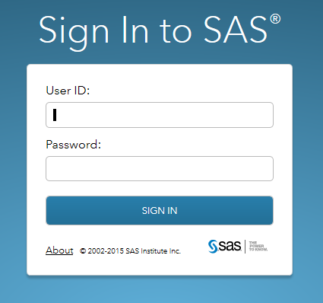
View the example
hoopla.this.home:81/SASStoredProcess/do?_Program=/MyApp/Page1

Slide 38
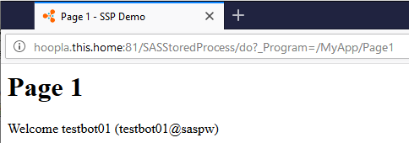
Example page
Unpack
hoopla.this.home:81
/SASStoredProcess/do
_Program=
/MyApp/Page1
&_METAPERSON
&_METAUSER
&_PROGRAM

Slide 39
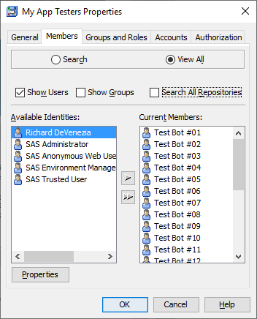
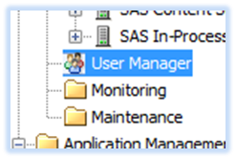

Metadata Server
Control Nexus
Management Console
Users and Groups
MyApp stored processes registered in folder MyApp
    _program=

Slide 40
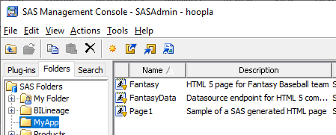
Metadata Server
MyApp stored processes registered in folder MyApp
    _program=

Slide 41
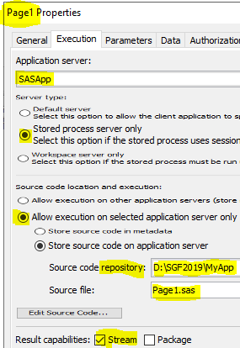
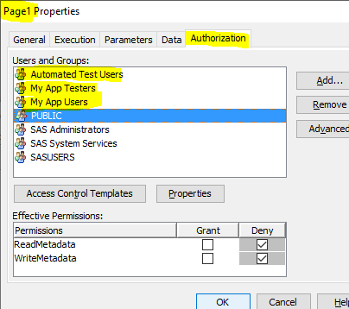
Metadata Server
MyApp stored process Page1

Slide 42
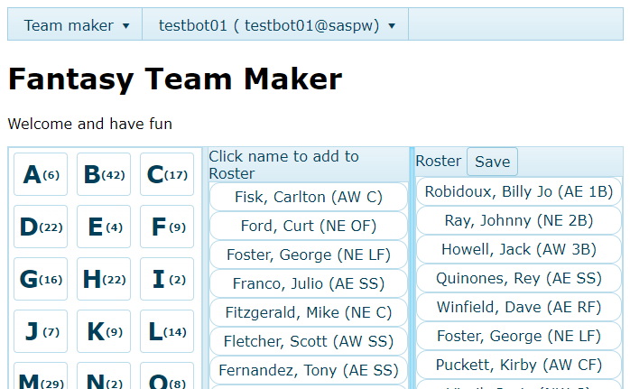
MyApp
_program=MyApp/Fantasy

Slide 43
Fantasy stored process
Proc STREAM
  PRESCOL option
HTML
  Includes JavaScript libraries and CSS
  jQuery
  3rd party HTML5 UI controls
  Ajax - FantasyData

Slide 44
Menu component
<ul id="menu">
<li>Team maker
<ul>
<li>SASGF 2019 - Dallas!</li>
</ul>
</li>
<li>&_METAPERSON (&_METAUSER)
…
<script>
$(document).ready(function() {
$("#menu").kendoMenu();
…

Slide 45
UI Containers
<div id="across">
<div class="split-pane" id="left-pane">
<div id="letters"></div>
</div>
<div class="split-pane" id="center-pane">
<div class="k-header">Click name to add to Roster</div>
<div id="names"></div>
</div>
<div class="split-pane" id="right-pane">
<div class="k-header">Roster <div id="save" class="k-button">Save</div> <span id="roster-msg">Click name to remove</span></div>
<div id="roster"></div>
</div>
</div>

Slide 46
Databound component
letters
$("#letters").kendoListView({
template: kendo.template(
'<div class="letter k-widget k-button" data-letter="#:letter#">
<h3>#:letter#</h3><br /><h4>(#:N#)</h4></div>'),
dataSource: {
schema: { type: "json", data: "letters",
model: { fields: [ "letter", "N" ] }},
transport: {
read: {
dataType: "json",
url:
"&_URL?
_program=&_PROGRAM.Data%str(&)
operation=Read%str(&)
for=letters"
…
_program=MyApp/FantasyData
mask

Slide 47
MyApp
_program=MyApp/Fantasy

Slide 48
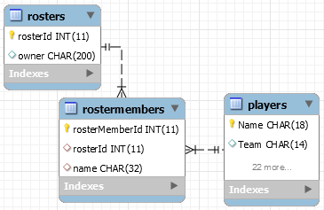
Fantasy – the Data
Rosters of players from sashelp.players
Roster designed by owner (metauser)
Roster has 1..N Players
Player can be in more
than one roster
Pick letter
Click player
  Add or remove

Slide 49
Web Applications
CRUD
Create
Read
Update
Delete
Fantasy

Slide 50
MyApp
Data endpoint dispatch
Dispatch invoked at end of STP code
%macro dispatch(); %local routine;
%let routine = &for._&operation;
%&routine
%mend;
%macro Letters_Read(); %* for=letters & operation=read
…

Slide 51
MyApp
%macro Letters_Read
SQL query – work.letters
select
upcase(name) as letter length=1,
count(*) as N
… group by letter
JSON Procedure
proc json out=_webout;
write values 'letters’;
write open array;
export work.letters / nosastags;
write close;
run;

Slide 52
FantasyData – Roster_Create
Save button
Send data as JSON
Array of objects
  { roster: { names: [ {name:name-1}, … , {name:name-N} ]}}
P OST
%macro Roster_Create
  JSON library engine

Slide 53
Databound component
roster (continued)
Create is Ajax call to STP endpoint
$("#roster").kendoListView({
… transport: {
create: {
type: "POST",
url: "&_URL?
_program=&_PROGRAM.Data%str(&)
operation=Create%str(&)
for=roster",
dataType: "json"
},
parameterMap: function (options, operation) {
return { roster: kendo.stringify( { names: $.map(options.models,function(m){return {Name: m.Name}})}) };

Slide 54
Databound component
roster (continued)
ParameterMap()
Constructs additional name=value pairs
The component sends
roster=%7B%22names%22%3A%5B%7B%22Name%22%3A%22Robidoux%2C+Billy+Jo%22%7D%2C%7B%22Name%22%3A%22Ray%2C+Johnny%22%7D%2C%7B%22Name%22%3A%22Howell%2C+Jack%22%7D%2C%7B%22Name%22%3A%22Quinones%2C+Rey%22%7D%2C%7B%22Name%22%3A%22Winfield%2C+Dave%22%7D%5D%7D
  Encoding of
  roster={"names":[
  {"Name":"Robidoux, Billy Jo"},
  {"Name":"Ray, Johnny"},
  {"Name":"Howell, Jack"},
  {"Name":"Quinones, Rey"},
  {"Name":"Winfield, Dave"}
  ]}

Slide 55
%macro Roster_Create
Copy "roster" macro variable to file
Libname roster JSON fileref=file
Roster.names "dataset“
Compute new identity values
Create new records in WORK tables
Append new data to application tables

Slide 56
%macro Roster_Create
%waitLock (mutex-name)
Proc append base=appdata.Rosters data=newRoster;
Proc append base=appdata.RosterMembers …
%clearLock (mutex-name)
Wait / Clear must bound shared resource

Slide 57
Take away
SAS Server environment is very configurable
Errors can occur despite best efforts to manage the configuration within the resources available
Thinking outside the box can yield success

Slide 58
Thank you!
Contact Information
rdevenezia@gmail.com
devenezia.com/papers
Reminder:
Complete your session survey in the conference mobile app.

